Slide 1

ONLINE PAYMENTS FRAUD DETECTION USING MACHINE LEARNING BY
TEAM MEMBERS:
G ANJALI -160722747125
K SRINIVAS -160722747306
G ABHISHEK -160722747307
GUIDED BY:
Mrs. H MEENAL, Assistant Professor Dept of CSE

Slide 2

ABSTRACT
Online payment fraud is becoming a serious issue due to the increasing use of digital transactions. Detecting fraudulent activity quickly is important to protect users and financial institutions from financial loss and data breaches. A machine learning model is developed to identify fraudulent transactions using a real-world dataset from Kaggle. The dataset contains thousands of credit card transactions, but only a small number of them are fraudulent, making the problem challenging. To prepare the data, techniques such as normalization and handling class imbalance are applied. The Random Forest algorithm is selected for its high accuracy and ability to handle imbalanced datasets. It works by combining the results of multiple models to make better predictions and reduce errors. The model is evaluated using performance metrics like accuracy, precision, recall, and F1-score, with a strong focus on correctly detecting fraud cases. Cross-validation is used to ensure the model performs well on different sets of data. Results show that Random Forest is effective in identifying fraudulent transactions with high precision and recall. These findings highlight how machine learning, especially ensemble methods, can improve the safety and reliability of online payment systems.

Slide 3
INTRODUCTION
Many people and businesses are now using digital transactions every day, which makes it important to protect them from cybercrime.
Traditional fraud detection methods often can't keep up with new types of fraud, so better solutions are needed.
Machine Learning (ML) is a powerful way to detect fraud. It can study large amounts of transaction data and learn to spot unusual patterns that might be signs of fraud.
The “Online Payments Fraud Detection with Machine Learning” shows how ML can be used to build a model that tells the difference between real and fake transactions.
The project uses a real dataset and walks through all the steps from cleaning the data and analyzing it, to training a model and testing how well it works.
Notes:
With the rise of online payments, the risk of fraud has also increased.

Slide 4
PROBLEM STATEMENT
Detecting online payment fraud by combining transaction history analysis with machine learning techniques trained on publicly available financial datasets. The system aims to overcome the limitations of traditional fraud detection methods by providing a lightweight, efficient, and real-time solution suitable for academic implementation, enhancing awareness and contributing to safer digital transactions.

Slide 5
OBJECTIVES
Develop a fraud detection system that is fast and scalable for real-time online transactions.
Minimize false positives while maintaining high fraud detection accuracy.
Ensure the system is easy to integrate with existing payment platforms.
Use diverse and real-world datasets to improve detection reliability.
Design the user interface to be intuitive and accessible for financial analysts and support teams.

Slide 6
LITERATURE SURVEY
S. No | Year | Authors | Title | Techniques | Research Gaps | Performance | Methodology | System Architecture
1 | 2018 | Nguyen et al. | Combining Oversampling and Undersampling for Imbalanced Datasets in Fraud Detection | SMOTE, Random Forest | Limited scalability to large datasets | Accuracy: 96%, Precision: 85% | Supervised learning with resampling | Traditional client-server model
2 | 2019 | Kumar & Sharma | Deep Learning Approach for Fraud Detection in Credit Card Transactions | CNN, LSTM | Requires large datasets and high computation | AUC: 0.98, Recall: 91% | Deep learning using sequence modeling | Layered architecture with data preprocessing, model layer, and prediction layer
3 | 2020 | Ali et al. | Anomaly Detection Using Autoencoders for Fraud Detection | Autoencoder (unsupervised) | Lacks interpretability; high false positives | Precision: 88%, Recall: 86% | Unsupervised anomaly detection | 3-tier architecture (data input, detection model, alert system)
4 | 2021 | Zhang & Liu | Graph Neural Networks for Fraud Detection in Financial Transactions | GNN, Node Classification | Complex to implement; limited real-time performance | AUC: 0.94 | Graph-based learning from transaction network | Graph-based architecture with transaction mapping layer

Slide 7
5/ | 2022 | Patel et al. | Real-Time Credit Card Fraud Detection Using Hybrid Ensemble Model | Random Forest + XGBoost + SVM | Computationally expensive for real-time use | F1 Score: 0.92 | Ensemble supervised learning | Modular architecture for parallel model processing
6 | 2023 | Chen & Wang | Federated Learning for Privacy-Preserving Fraud Detection | Federated Learning, Logistic Regression | Model convergence issues; communication overhead | Accuracy: 93% | Distributed ML with local model training | Decentralized client-server with aggregation server
7 | 2024 | Rao & Singh | Explainable AI for Fraud Detection in Online Payments | SHAP, Decision Trees | Balancing performance with interpretability | Precision: 89%, Explainability: High | Interpretable ML with post-hoc analysis | Pipeline architecture with XAI integration

Slide 8
METHODOLOGY
Techniques and Models Used: The project employs a combination of machine learning techniques and statistical analysis to develop a fraud detection system.
Data Preprocessing: Cleaning and preparing data for analysis.
Model Selection: Utilizing algorithms such as Random Forest, Support Vector Machines, and Neural Networks.
Project Workflow: The project follows a structured workflow, which includes:
Data Collection
Data Preprocessing
Model Training
Model Evaluation
Deployment

Slide 9
DATASET & TOOLS USED
Kaggle Datasets: Datasets from Kaggle that provide a rich source of transaction data for analysis.
Software: Python, Jupyter Notebook
Libraries: Scikit-learn, Pandas, NumPy, Matplotlib
Hardware: Standard computing resources with sufficient processing power for model training.
Tools and Technologies Used :
Python Libraries:
numpy
matplotlib and seaborn
pandas
sklearn (Scikit-learn)
Environment:
Jupyter Notebook (or similar Python IDEs)

Slide 10
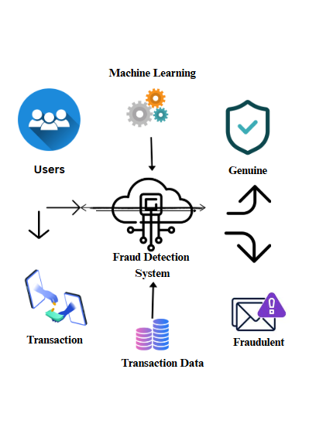
SYSTEM ARCHITECTURE

Slide 11
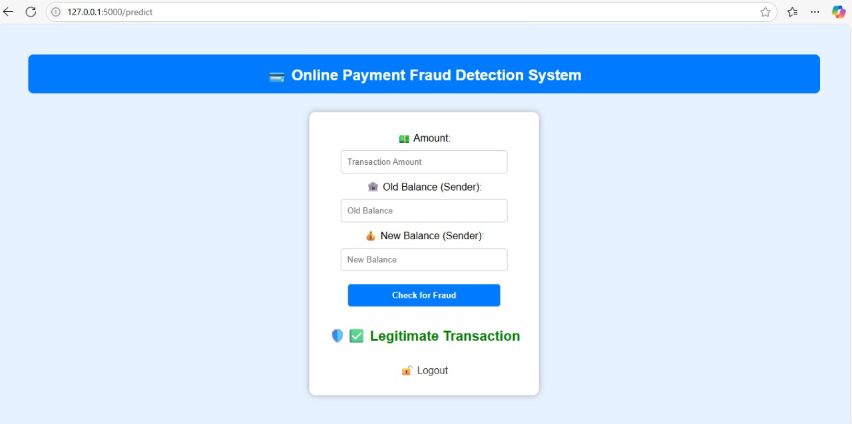
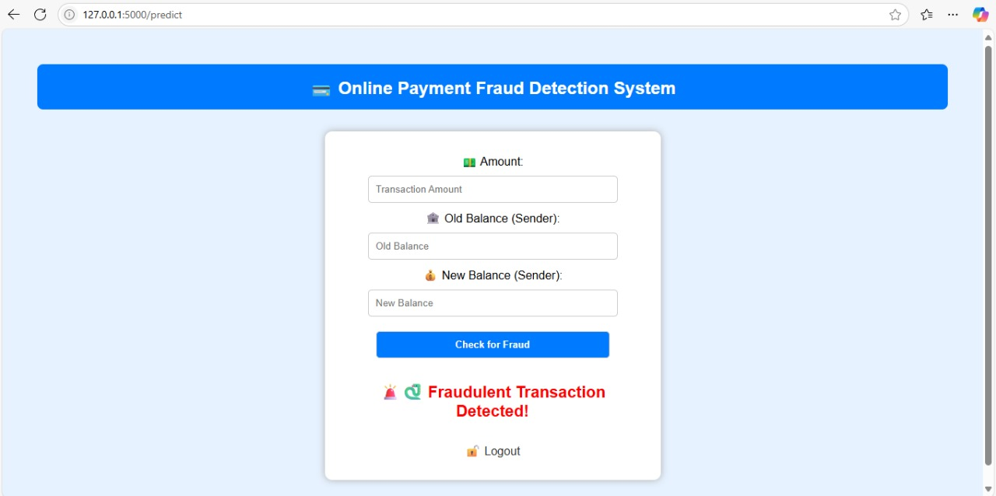
OUTPUT SCREEN :

Slide 12
CONCLUSION
This project focuses on detecting online payment fraud using a machine learning approach with a Decision Tree Classifier. After training the model on transaction data and achieving high accuracy, the model was integrated into a web application using Flask. The web interface allows users to input transaction details such as type, amount, and account balances, and instantly receive a prediction on whether the transaction is fraudulent. This integration makes the system both intelligent and user-friendly, providing a practical solution for real-time fraud detection in financial transactions.

Slide 13
REFERENCES
Kharwal, A. (2022). Online Payments Fraud Detection with Machine Learning.
Chawla, N. V., & Bowyer, K. W. (2002). SMOTE: Synthetic Minority Over-sampling Technique. Journal of Artificial Intelligence Research, 16, 321–357. doi:10.1613/jair.953
Ahmed, M., & Mahmood, A. N. (2018). A Survey of Network Anomaly Detection Techniques. Journal of Computer Science, 14(4), 459-469. doi:10.3844/jcssp.2018.459.469
PaySim (2021). Mobile Money Fraud Detection Dataset. Kaggle. Retrieved from https://www.kaggle.com/datasets/ealaxi/paysim1
Liu, Y., & Yang, Y. (2020). Fraud Detection with Machine Learning: A Comparative Study. International Journal of Data Science and Analytics, 9(1), 51-62. doi:10.1007/s41060-020-00147-0

Slide 14
THANK YOU.

